Slide 1

Production Lab

Slide 2
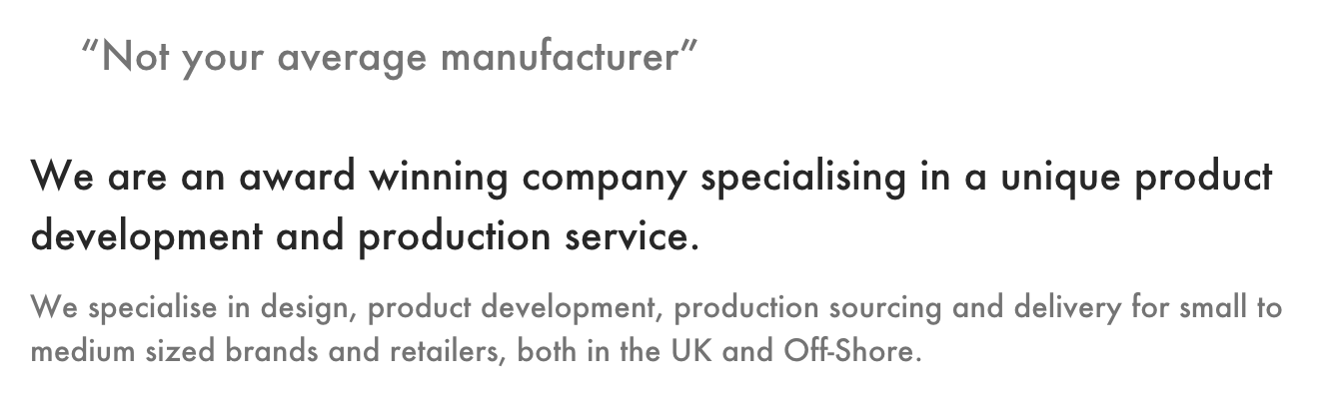

Slide 3
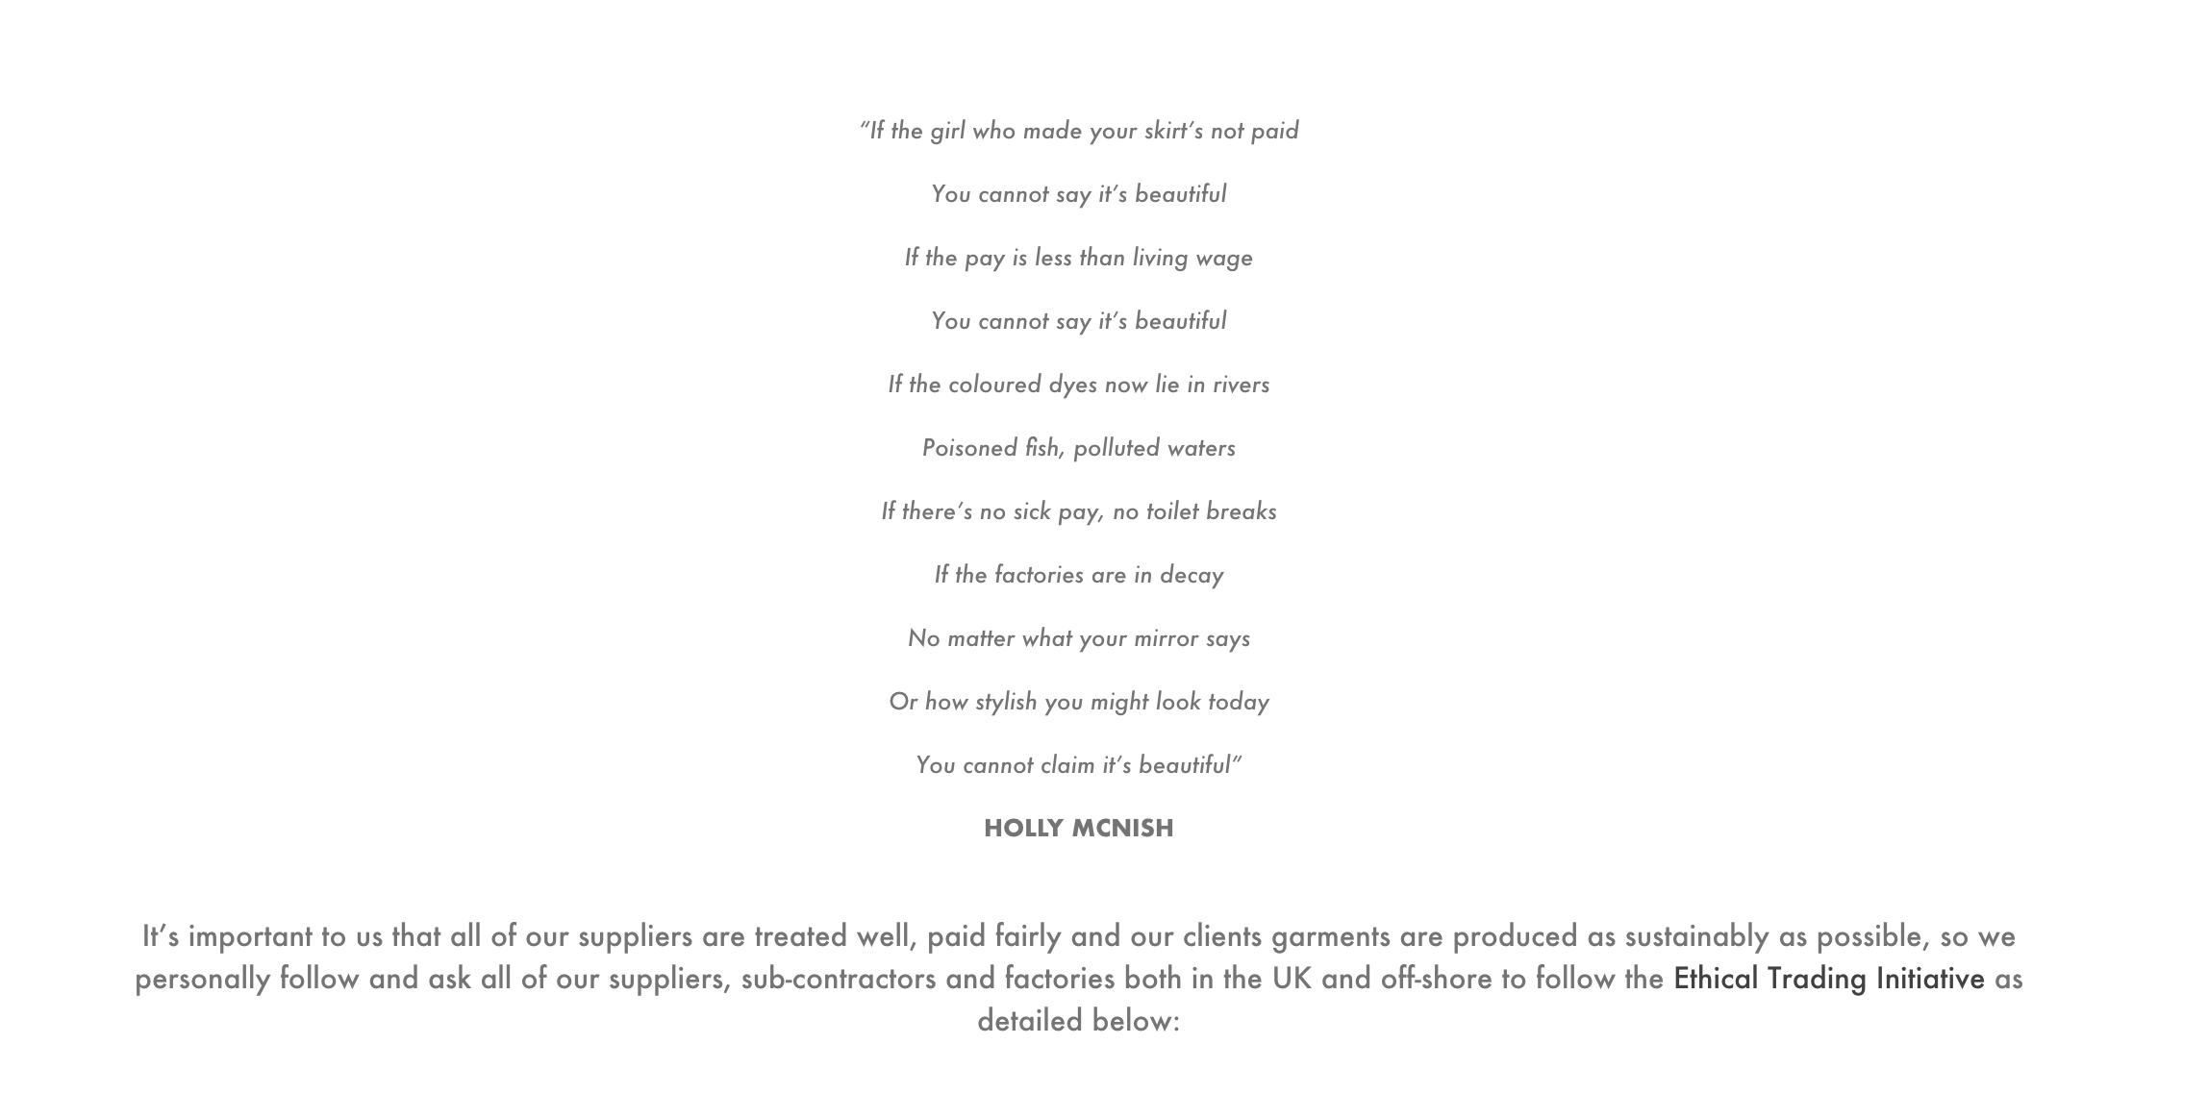

Slide 4
FAQ

Slide 5
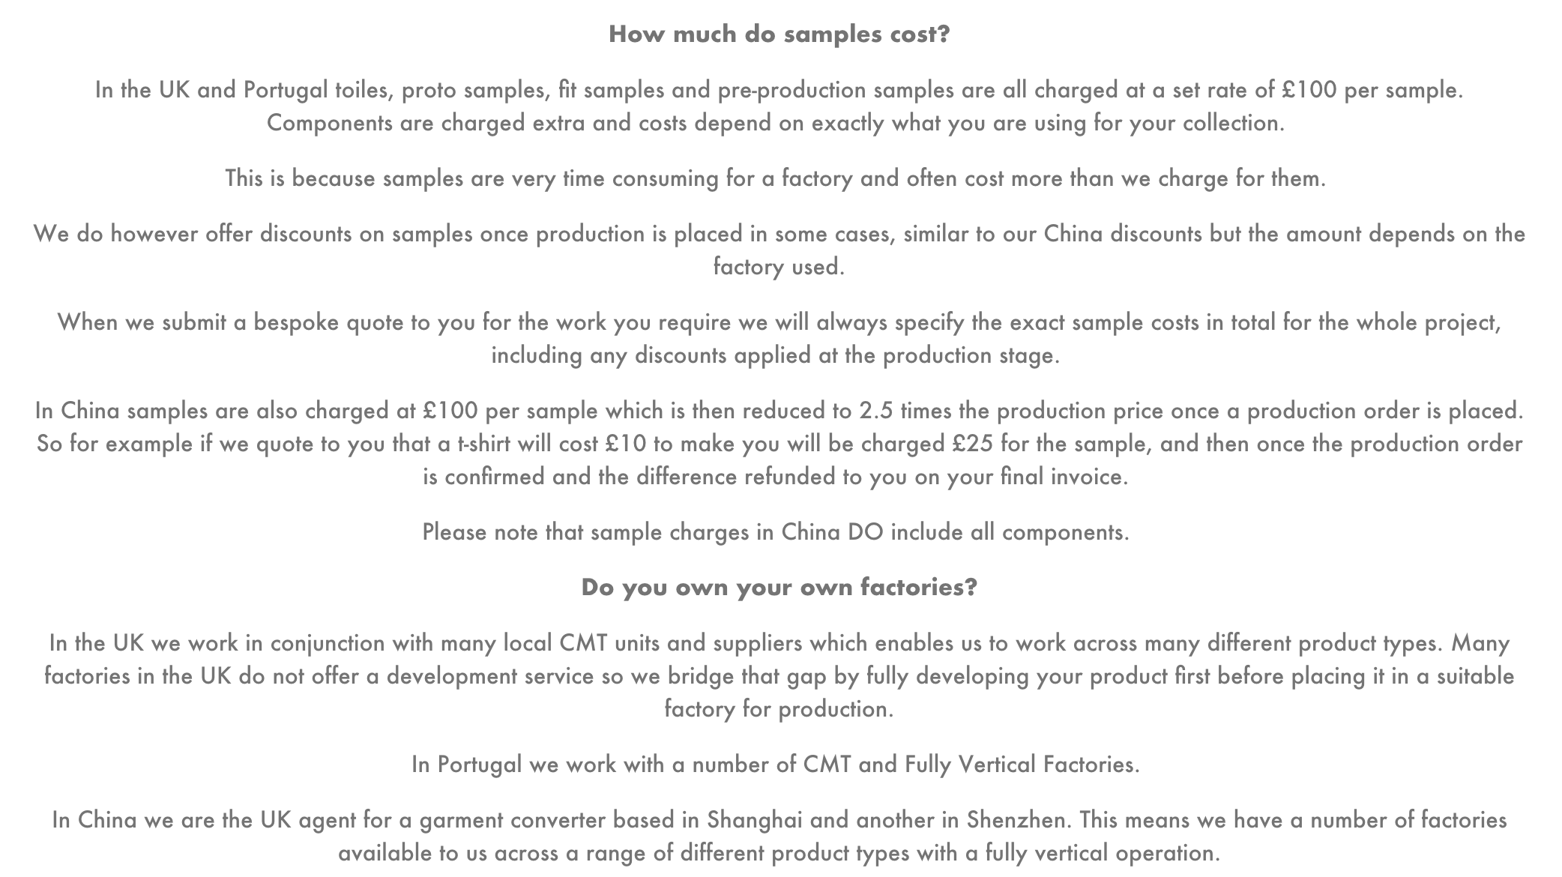

Slide 6
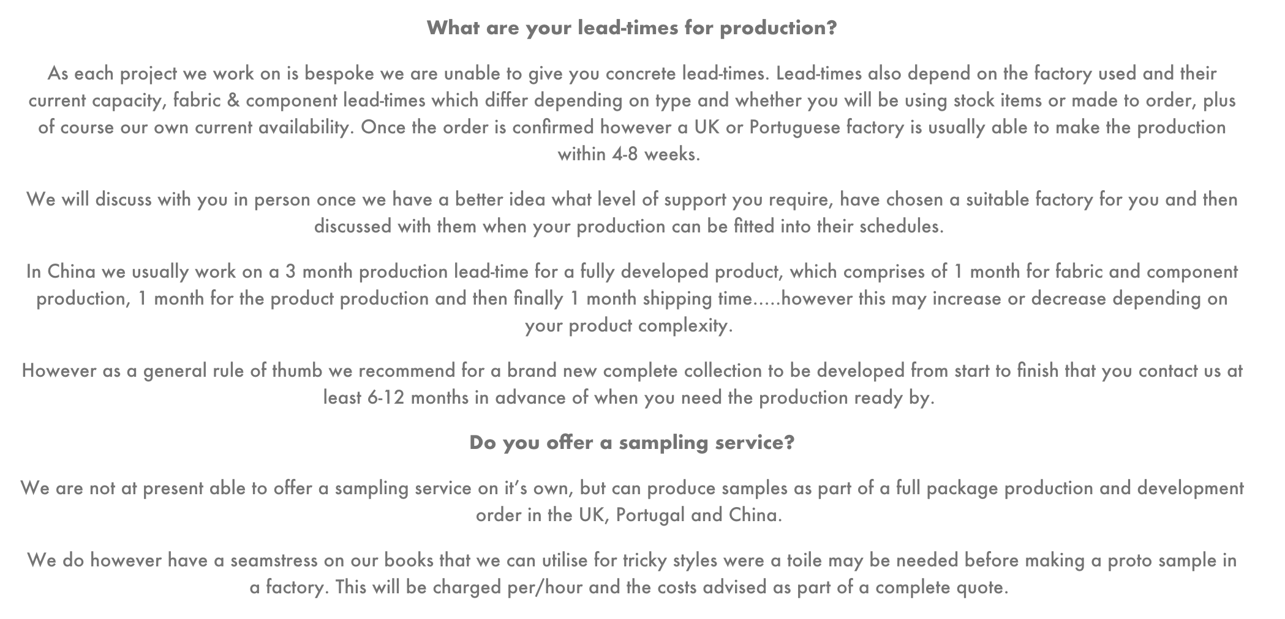

Slide 7
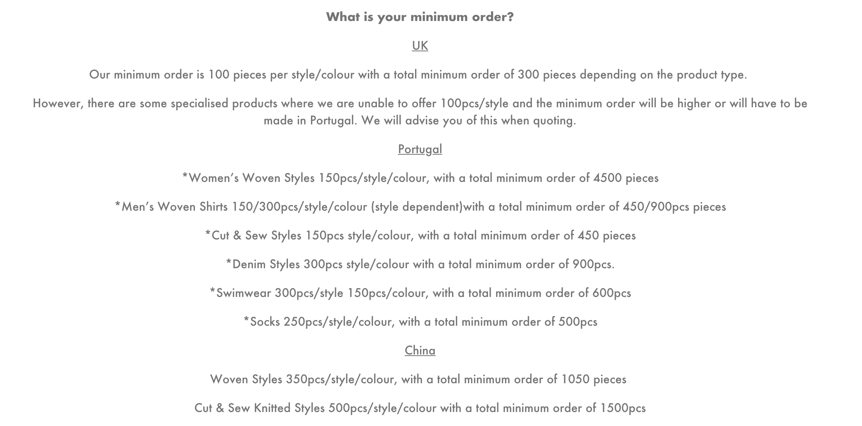

Slide 8
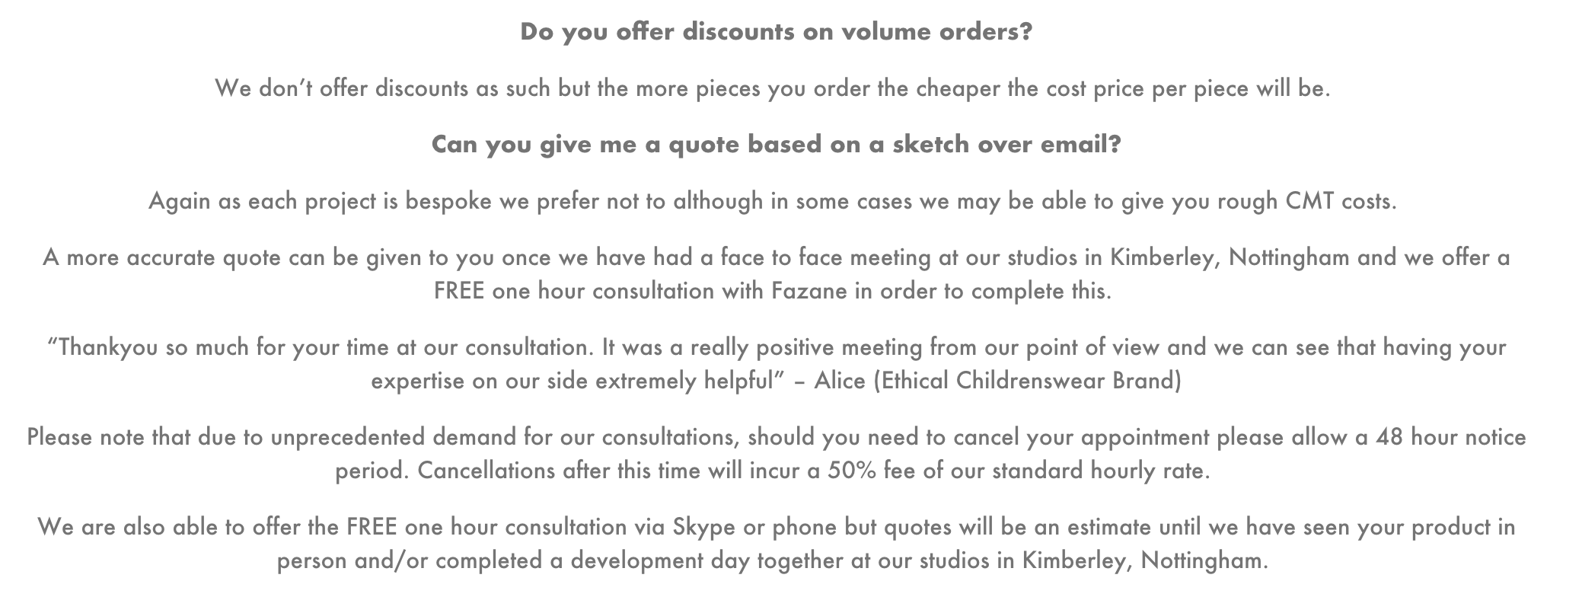

Slide 9
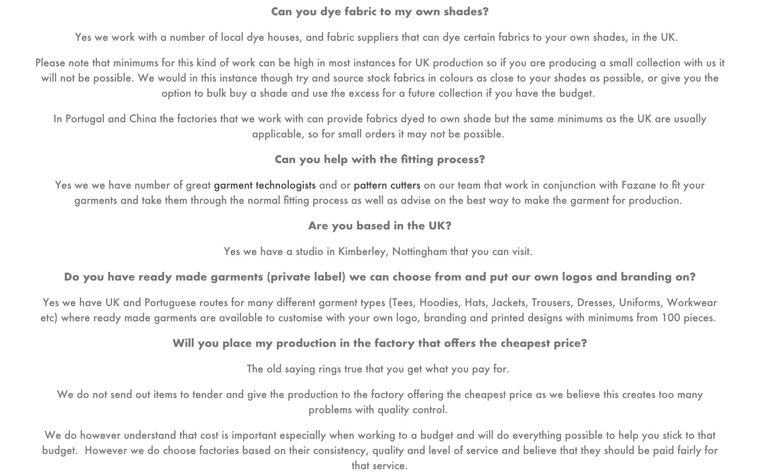

Slide 10
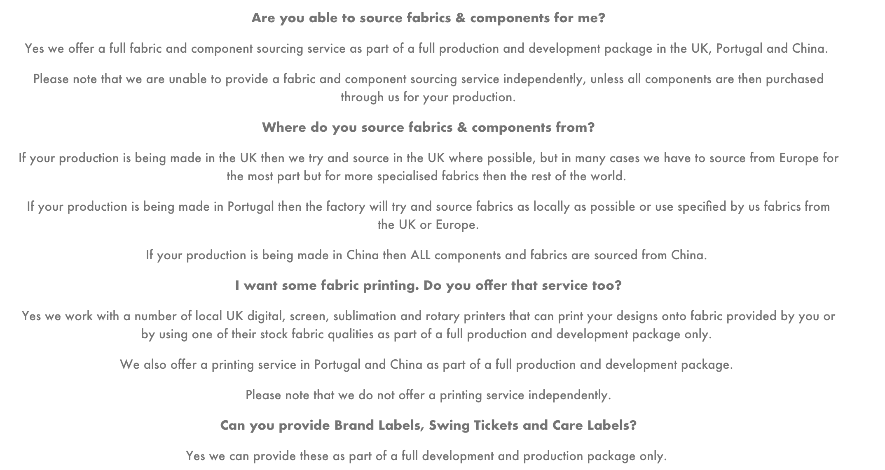

Slide 11
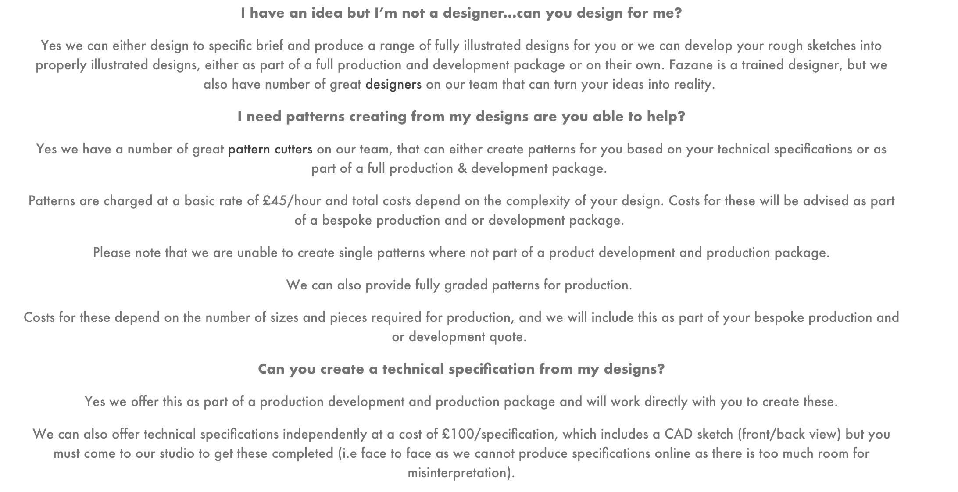

Slide 12
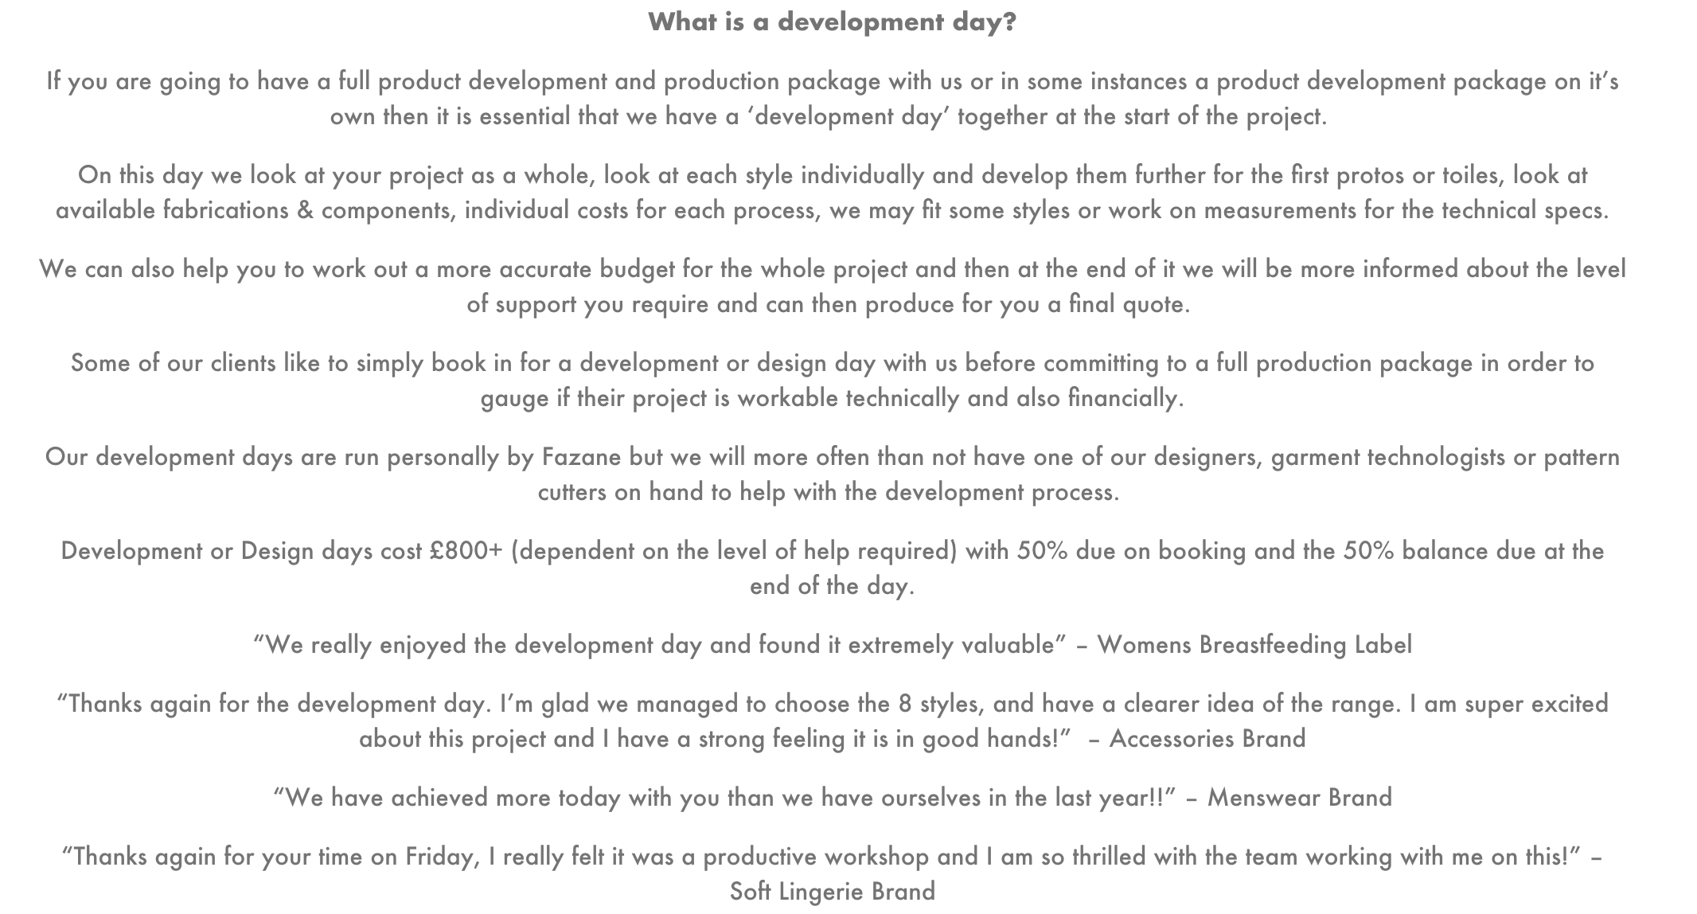

Slide 13
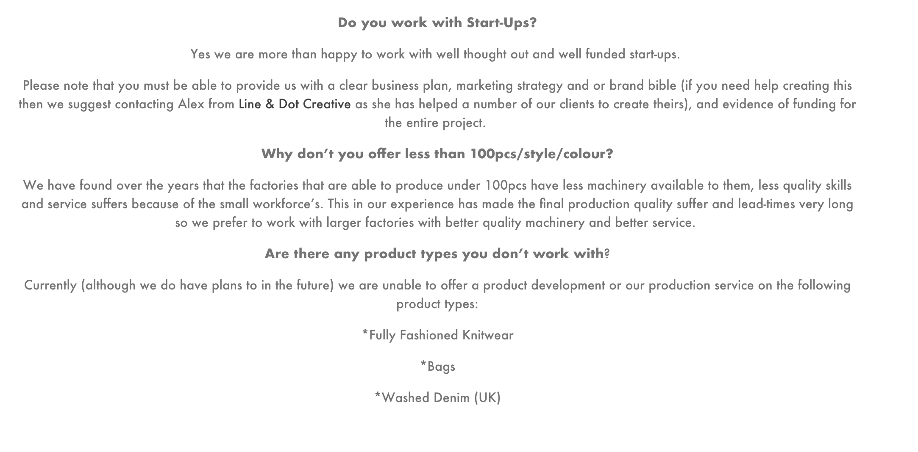

Slide 14
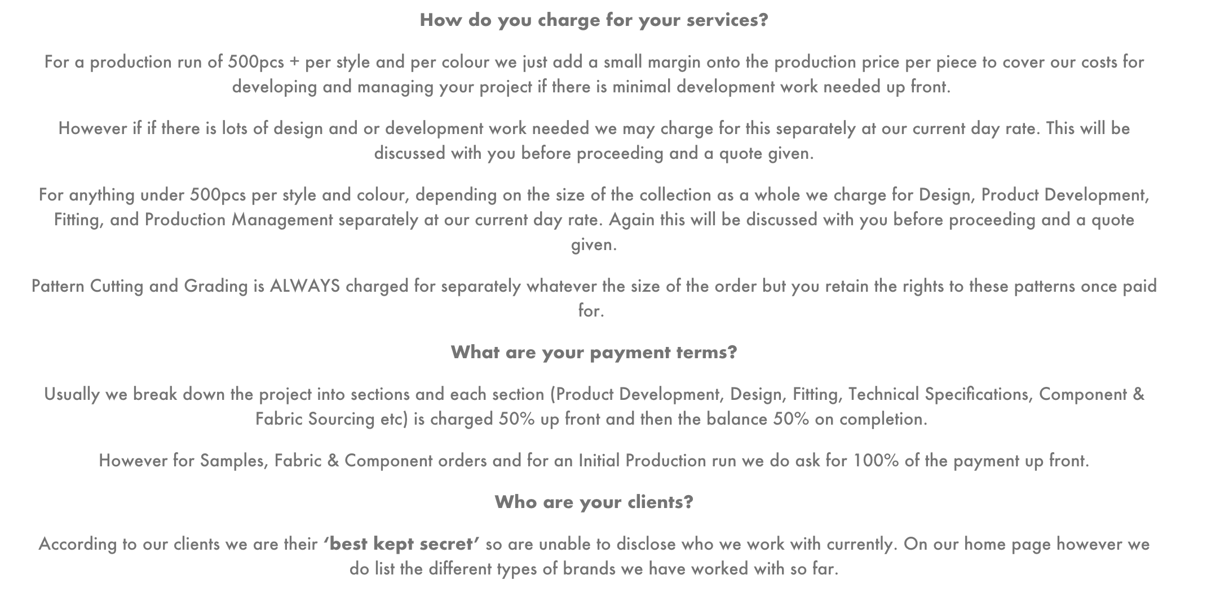

Slide 15
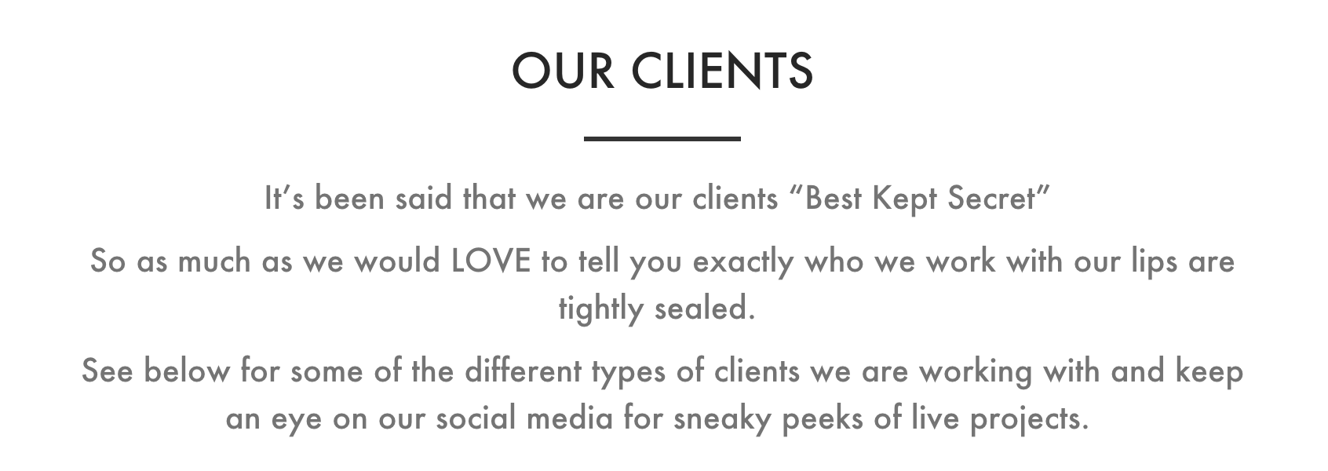

Slide 16
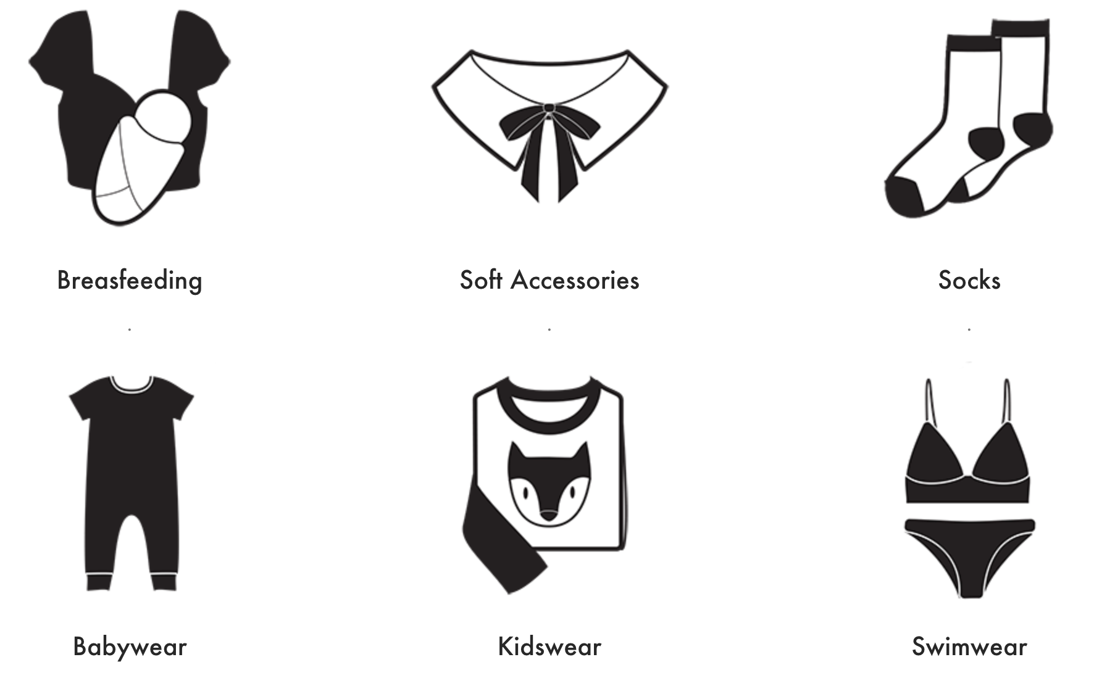

Slide 17
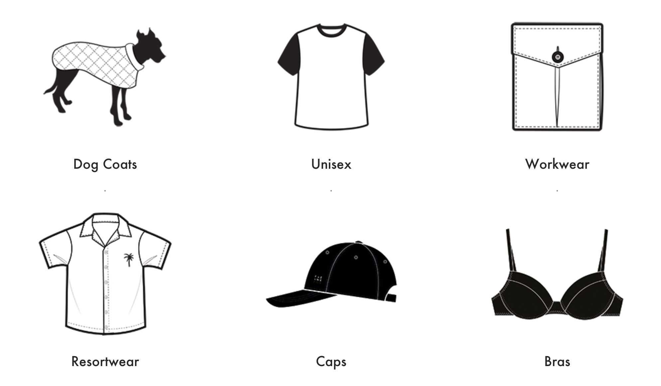

Slide 18
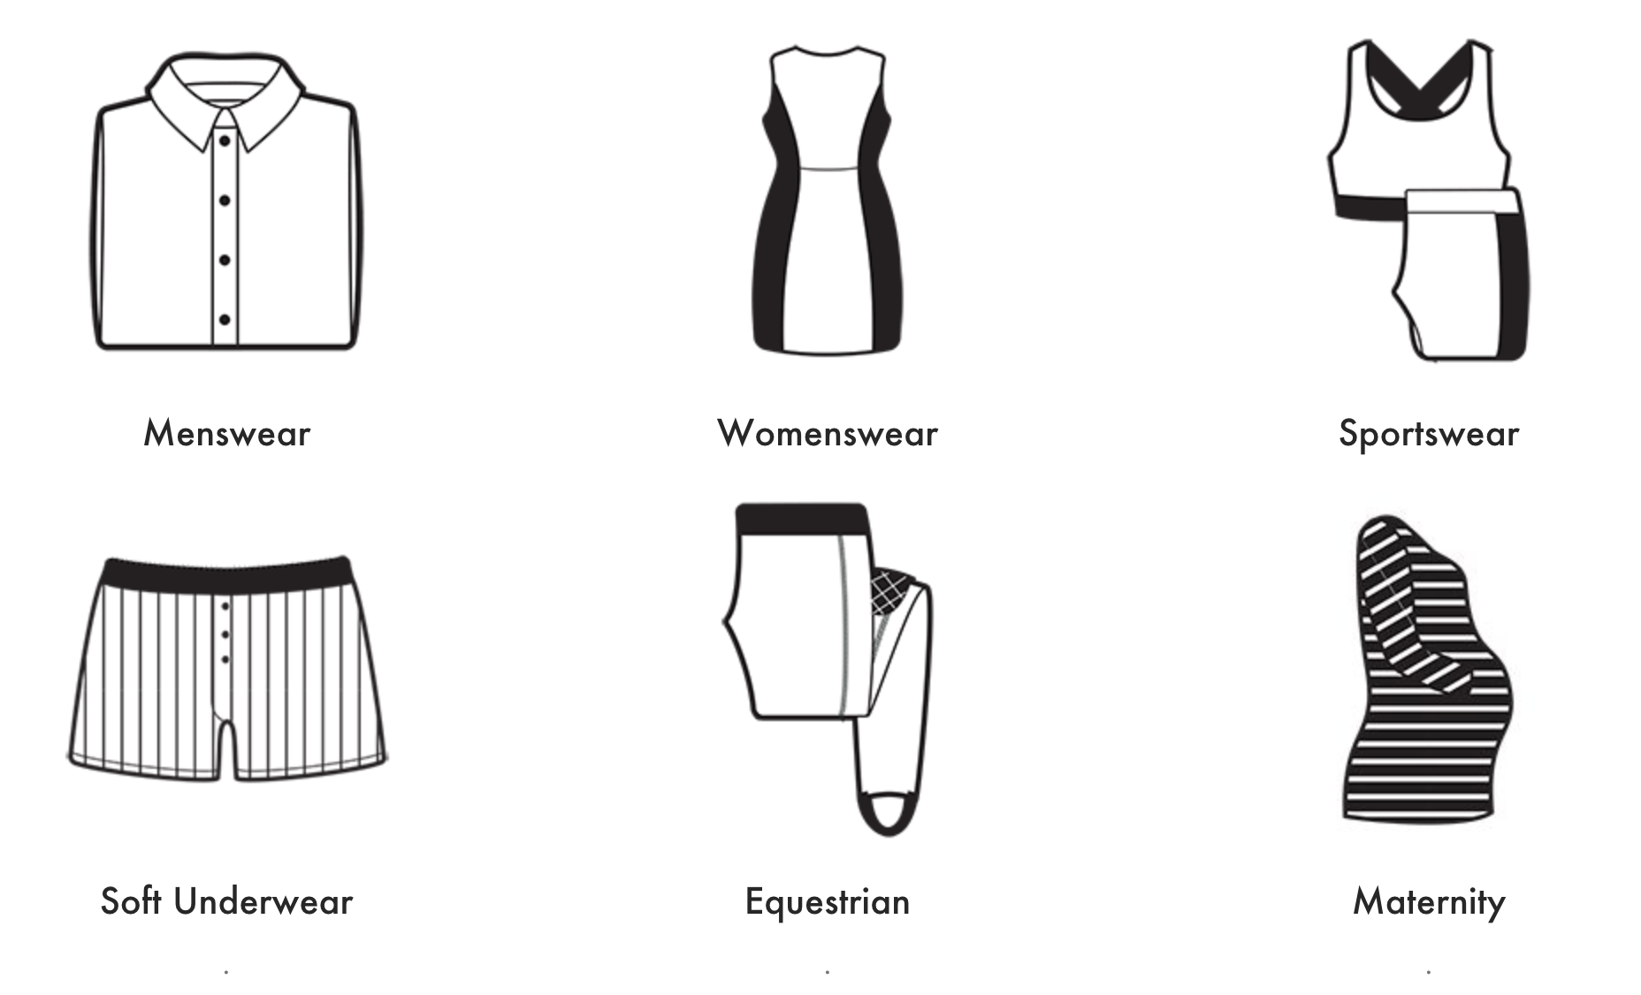

Slide 19
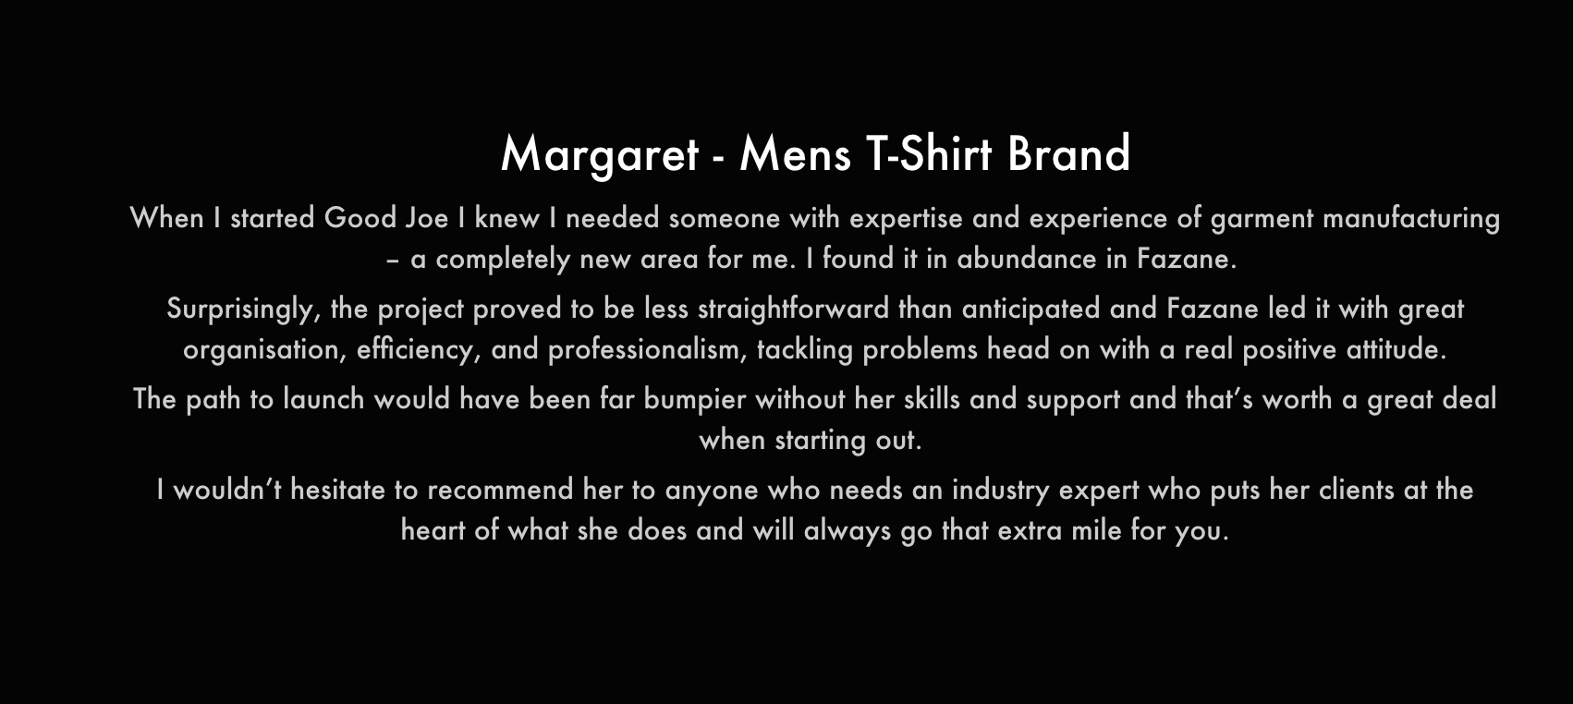

Slide 20
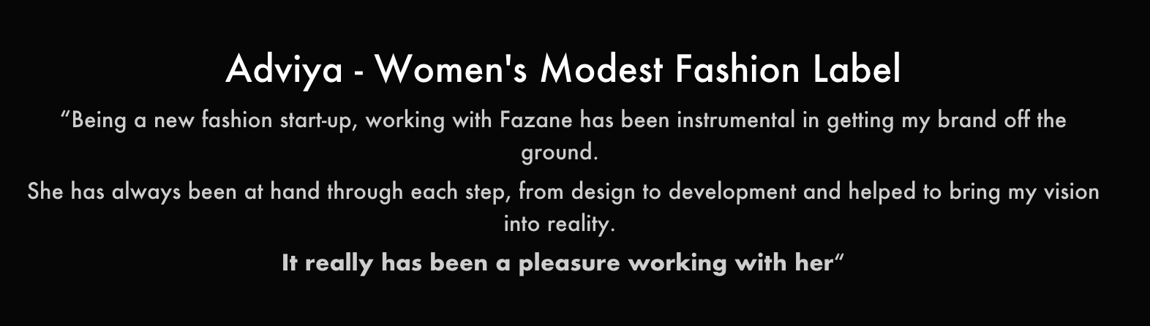
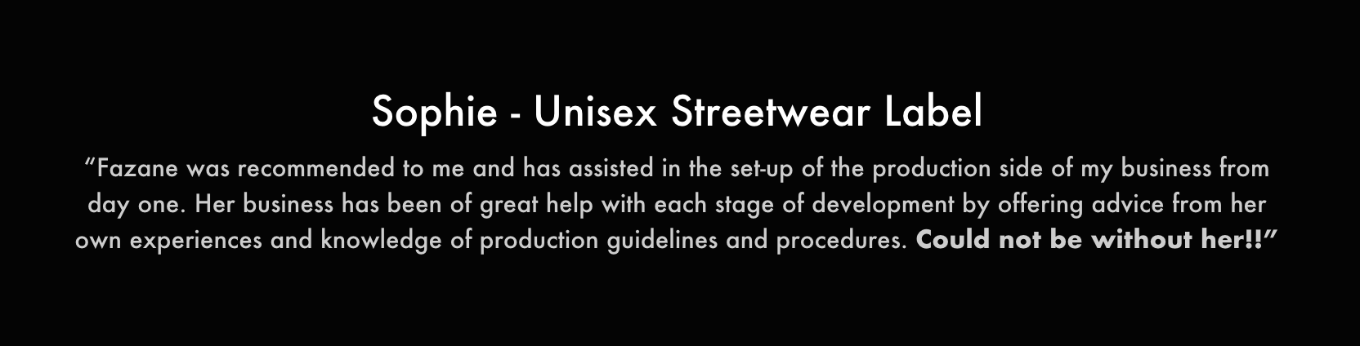

Slide 21
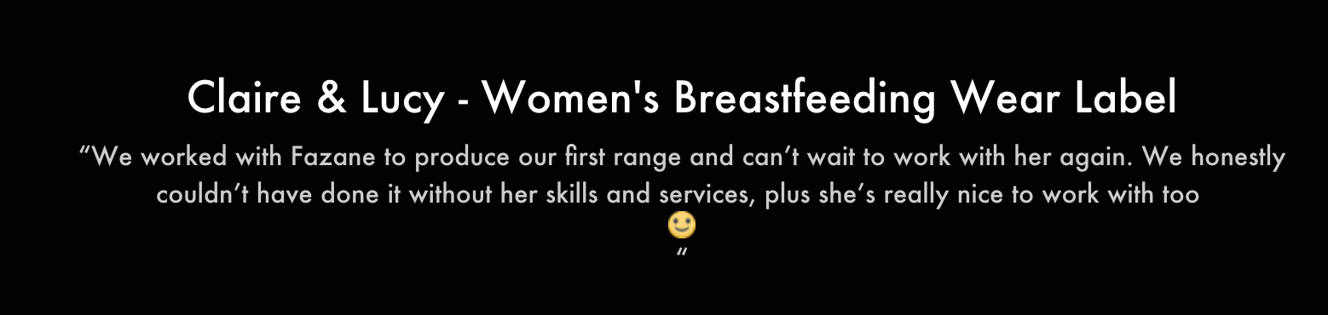
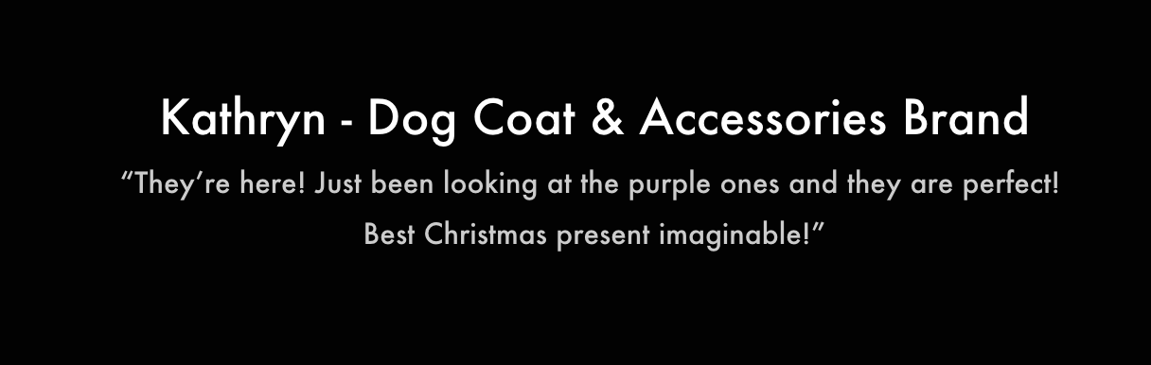

Slide 22

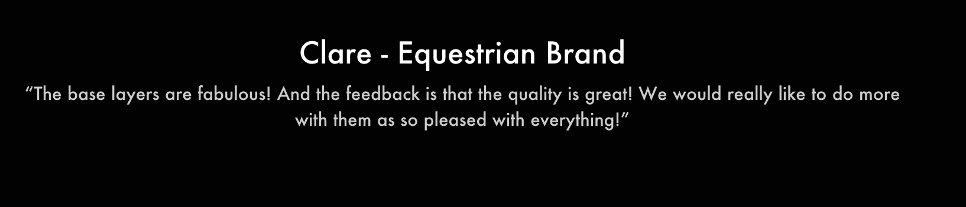

Slide 23
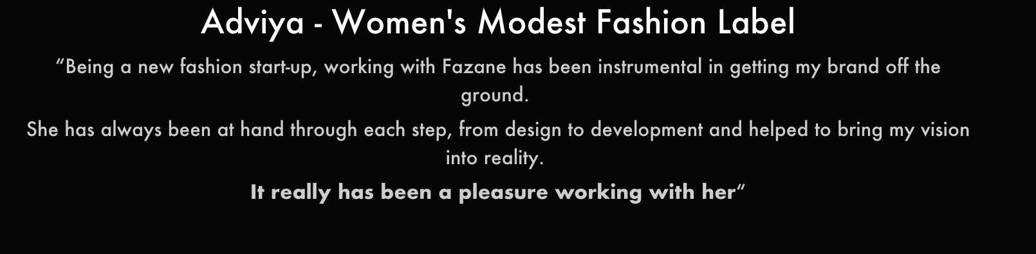
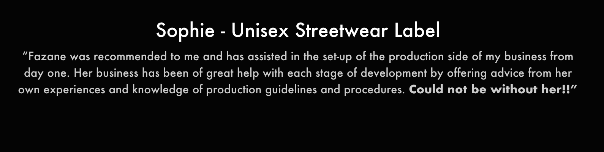

Slide 24
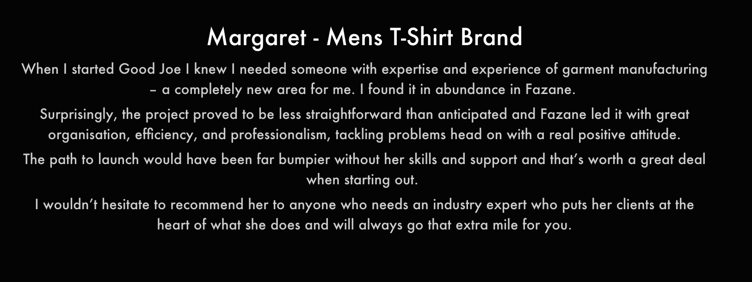
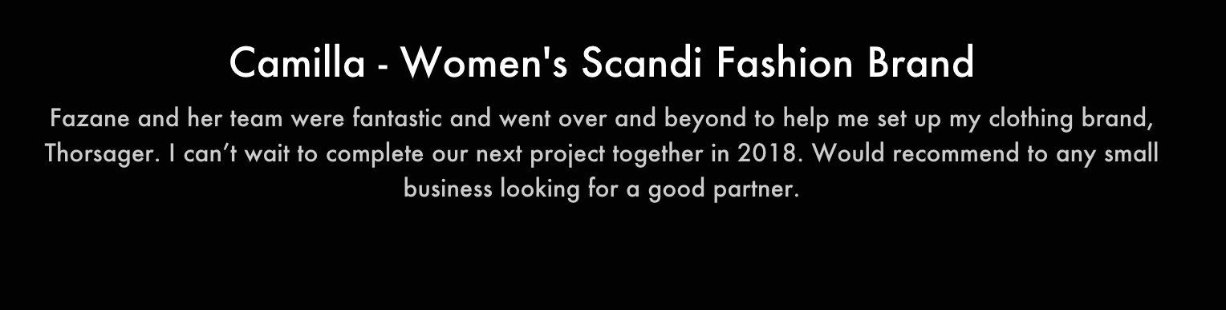

Slide 25
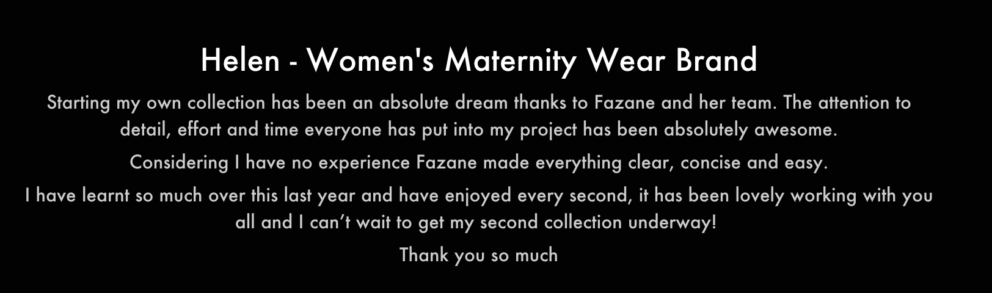
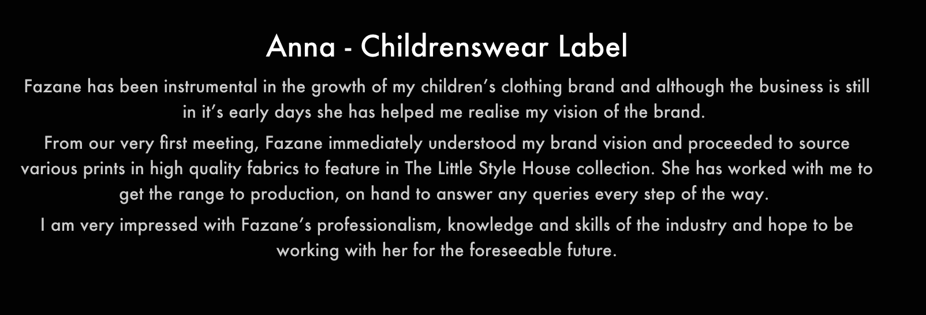

Slide 26
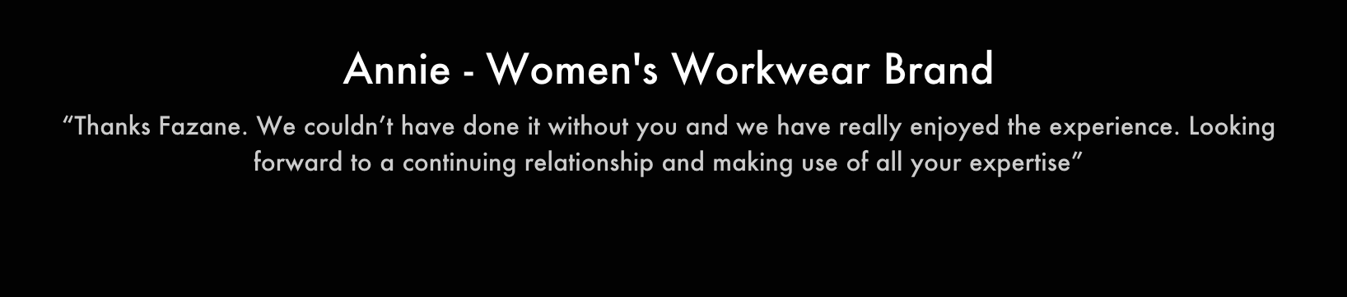

Slide 27

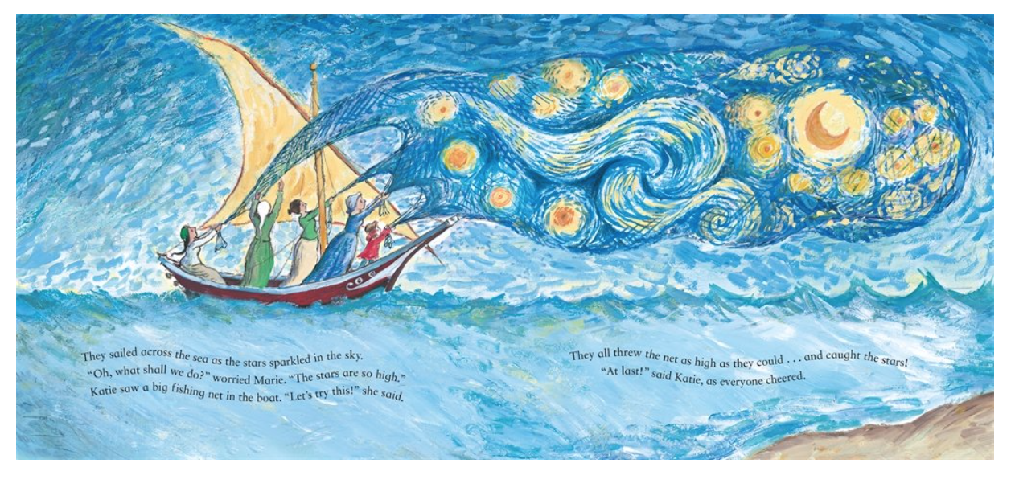
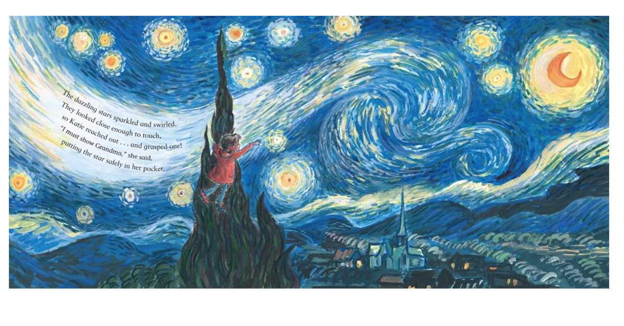
5th February
Another New potential Client, wanting to start a quality and ethical children's pajama brand.
Her inspiration has come from the Vincent Van Gogh Children's books which she reads to her daughter. In particular Katie and the starry night.
She spoke about her brand being called Starry Starry Night and the packaging would be a star shaped box which opened up.
Fabrics she likes are 100% merrino cotton and would like this etically sourced and traceble, she has chosen this type of fabric as it is temperature regulated and good for childrens pyjamas.
Brands she is inspired by are Chasing Windmills, Polarno Pyret and Cosilana.

Slide 28
We spoke about age range of maybe 1-2, 3-4, 5-6,7-8 and 9-10 using a design where the top has a cross over.
Also Baby wear 0-3, 3-6 and 6-12 months using a design maybe with a zip.
Print wise ahe would like a similar swirl print which is seen in the book and we spoke about an all over print being more cost effective when coming to cut the fabric. Maybe an experiment with digital print and screen print would be necessary.
Regarding Factories it would be more expensive to produce in the UK than Portugal but the client is wanting it to be all UK based.
Update 8th March - Client is returning for a development day and is now talking about the use of spider silk! Which we need to research.

Slide 29
22nd February
New Client Consultation
New Men's Streetwear Brand
The brand is to symbolize united strength – client a football fan
He showed us some drawings a friend of his did and there was a collection of about 8 garments.
He spoke about his inspiration being brands such as Napaorgi, Buffalo and Alma
He has a logo that needs developing which is something we can do as a company.
We talked about manufacturing – To have garments manufactured in the UK its a min of 100 pieces and a jacket would cost between £70-£80 to make.
If manufactured in Portugam the min order is 200 pieces but the cost for a jacket to be made would be £40-£50.
Fazane was going to email him within a week with an overall idea of cost.
Update 8th March– Client would like to go ahead with a development day and will probably start with 2-3 garments for the collection.

Slide 30
8th March
Fazane had been away visiting a range of current factories which we work with in Portugal as well as fabric suppliers. So today started off with a catch up regarding where we are with each client. All clients below are Top Secret ant therefore I cannot share their brand name.
Client P – This brand is about Breast Feeding scarves and Kids scarves
Bulk fabric has been ordered for March
Samples have been approved – no changes
They have chosen 8 samples from hicks and hicks
Will go straight to production once fabric has arrived.
Client A – Men's Shirt Brand
Not heard from business owner
Need to draw up a contract for the future regarding time scale the client has after development day up to going ahead with manufacturing as it is holding the business back and unable to commit to other clients.

Slide 31
Client J – Children's Clothing – Colourful Dungarees and Playful Print tops
Having to remake dungarees as they were slim fit and were passed off by the client. They are now saying they want the hips wider.
Where the popper on on the shoulder of the tops, this needs interfacing as poppers are ripping through the fabric. Although we haven’t tested interfacing on the rib and feel this may be a stumbling block.
The factory have informed us that there is a lot of cord fabric left and need to talk to client about using in another phase.
Client GE – Stem Themed Pajamas for Girls
Happy with sample, no changes
They client need to source a model for fitting
We talked about a client disclaimer regarding trying on samples to make it a requirement for them to source models otherwise we cant make any changes once gone to production.
Needs to go to production stages asap

Slide 32
Client M – Bright Print Legging Brand
Fabric being cut ready for production
Although the fabric isn't correct
The client is unhappy with the navy thread on the inner leg against the white side of the fabric.
Due to the fabric issue, we discussed that we will request a sample of all bulk fabrics delivered to us and also all pre production made in the same fabric as the final piece.
Client S – Menswear -Shorts
The sample which was taken from bulk was rejected
The one colourway chosen was incorrect.
It was decided 5 styles were to be made

Slide 33
Client A – Lingerie
Fabric has gone to the factory
Fit comments are fine
Pattern needs printing for client
Using one colourway for now
Client L – Beachwear Brand
Fabric currently being woven and dyed
Care labels were rejected as the printing was not central on the label
Client P – Breastfeeding Tops
Pattern being reshaped
Clients needs to compromise on curve due to grading the pattern
We feel they have been amending patterns themselves
The binding seems to wide on the openings it needs to be between 5mm – 1cm
Client L – Washable Sanitary Towels
Client has received fabric swatches
Once client has decided on fabric we can then get a proto sample made

Slide 34
Client A – Ethical Children's Wear
Sample Garments poor quality construction
Fabric different on jersey tops, there for not sitting correctly around the neckline. We have suggested to press well and lay flat when packed.
Loop back fabric not sitting correctly on harems due to the loops being far apart, we have suggested cuffed legs.
Client not happy with production time of 3-4 weeks. Factory making 100 pieces a day and have put a hold on their other clients to get this collection out asap.
Client C – Jersey Tops
Samples submitted
Arms are to long
Styles now currently being amended and Graded.
Client P – Vegan Underwear
Waiting for fabric to be woven
Soon to go to production

Slide 35
Client BB – Dog Beds
All components have arrived
Client would like a meeting to see all components before making proto sample
Client SD – Children's Clothing Brand
New Brand
I put together all samples today to send to client.
Client SC – Men's Wear
Client scaling down collection
Client BF – Children's Wear
Moving to us from another company. Precious coming wont let client have current patterns

Slide 36
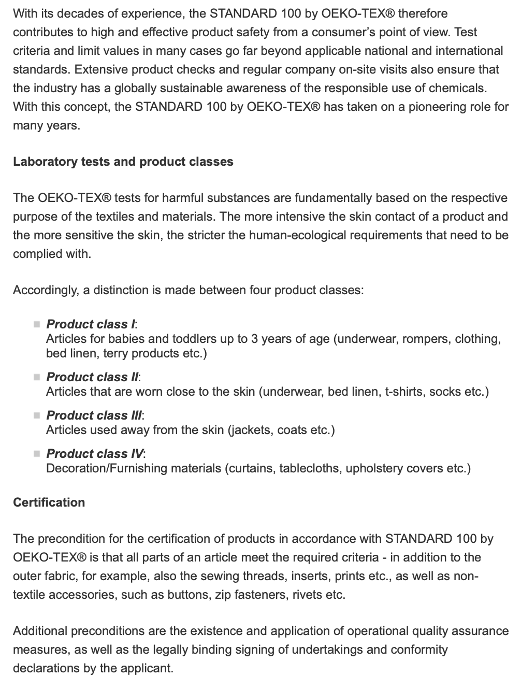
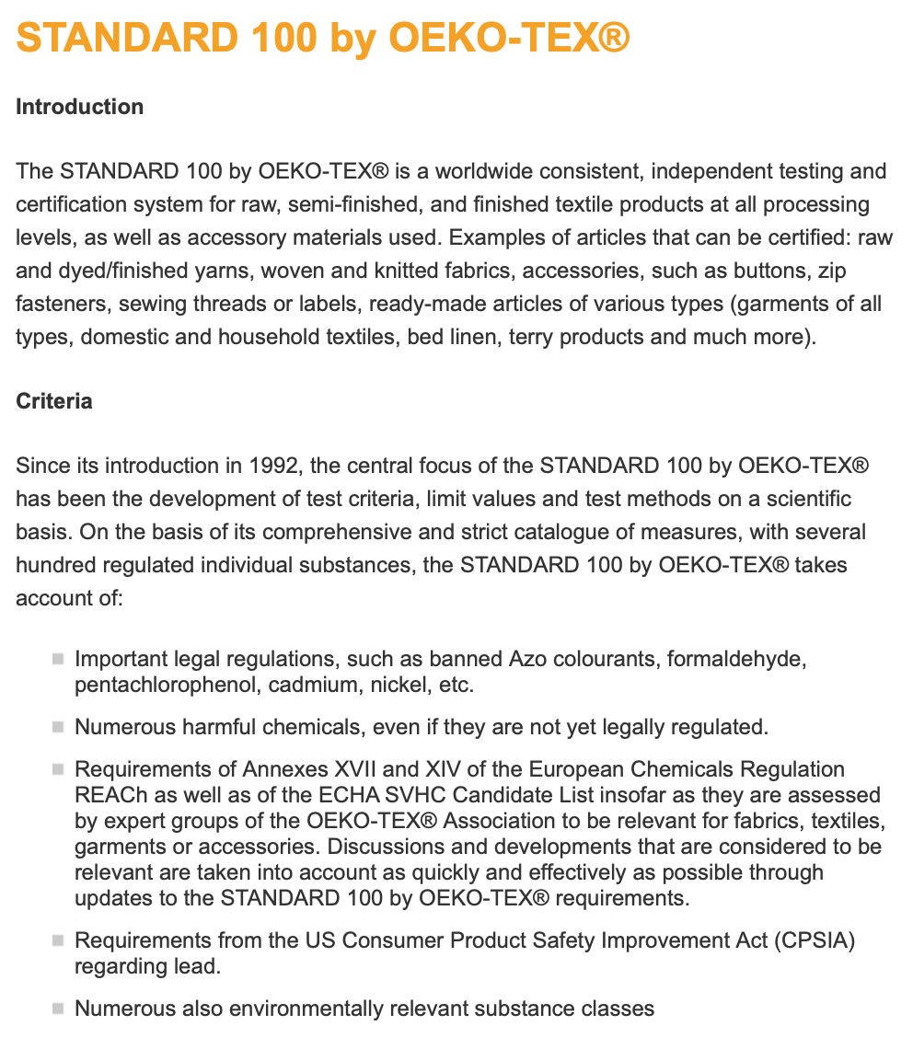
Other things a learnt today

Slide 37
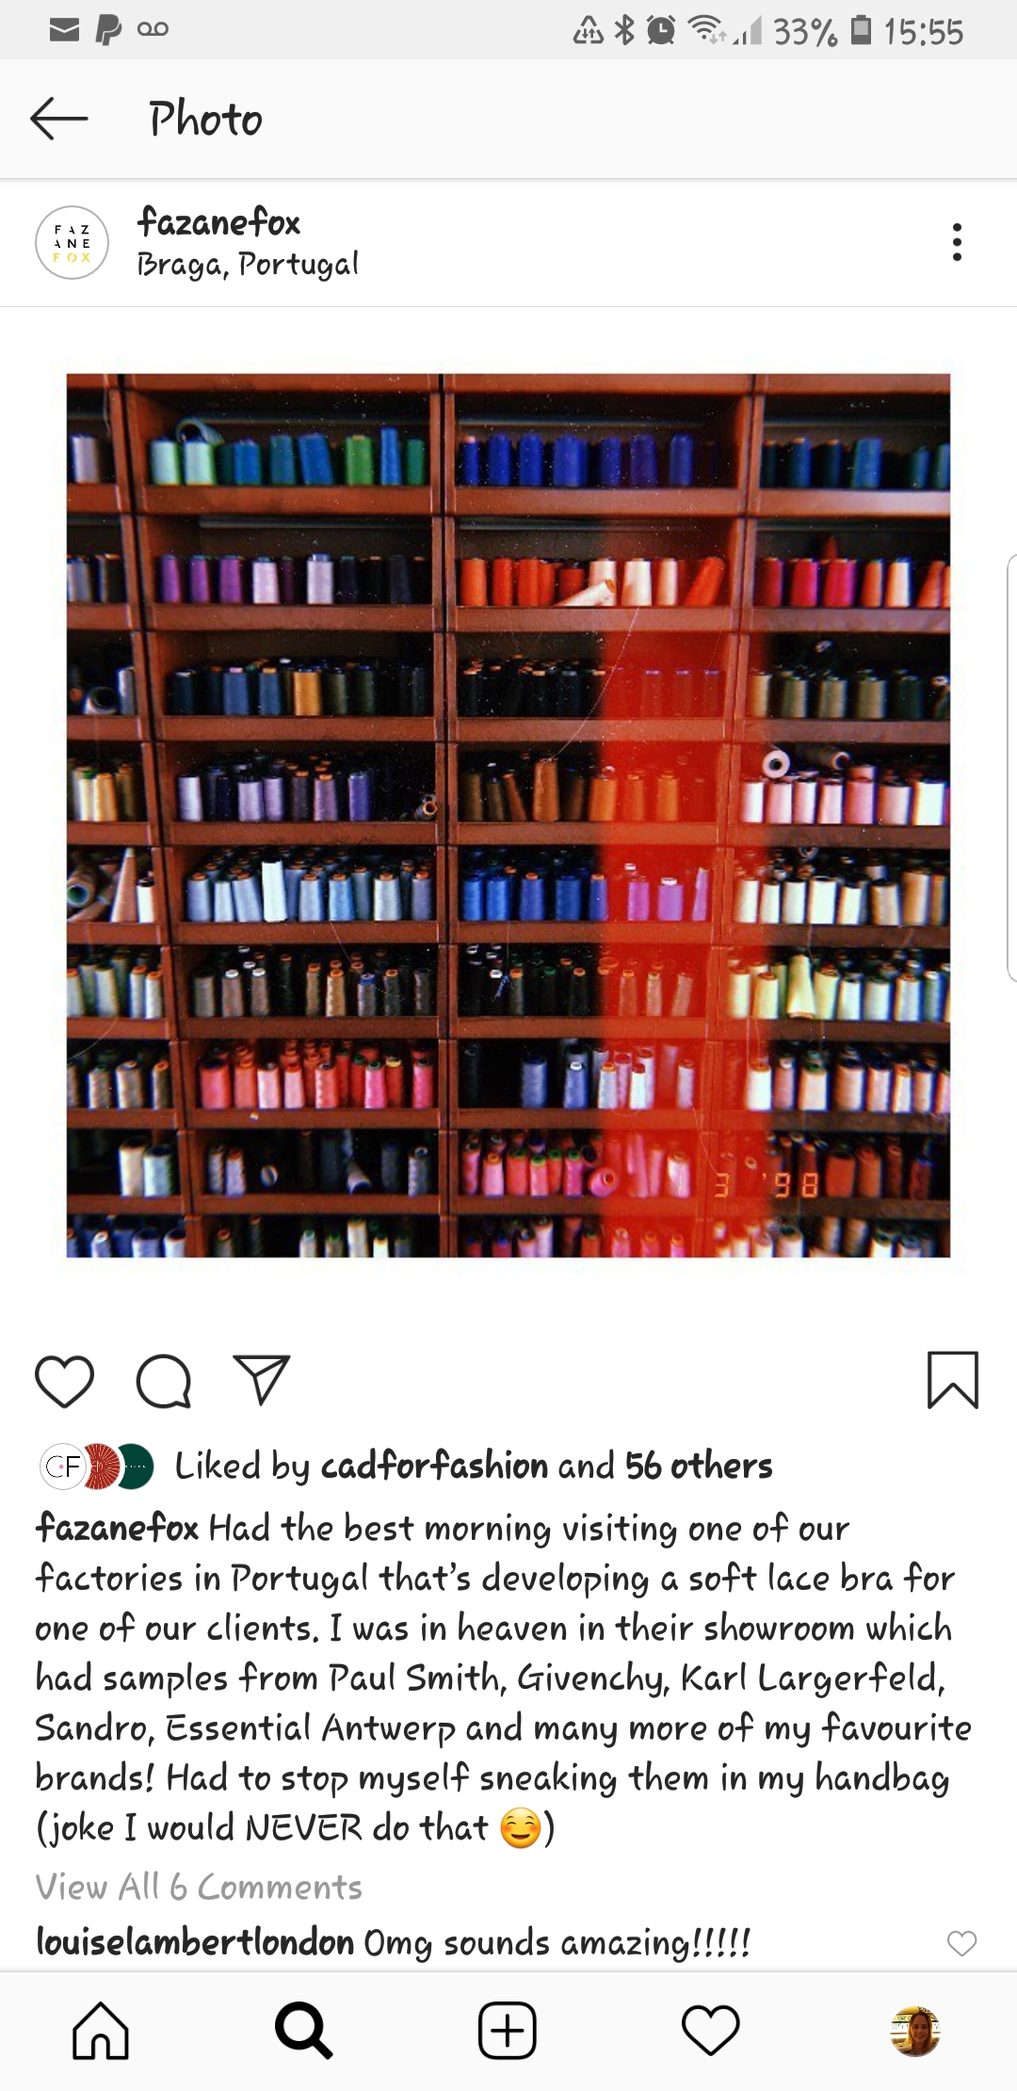
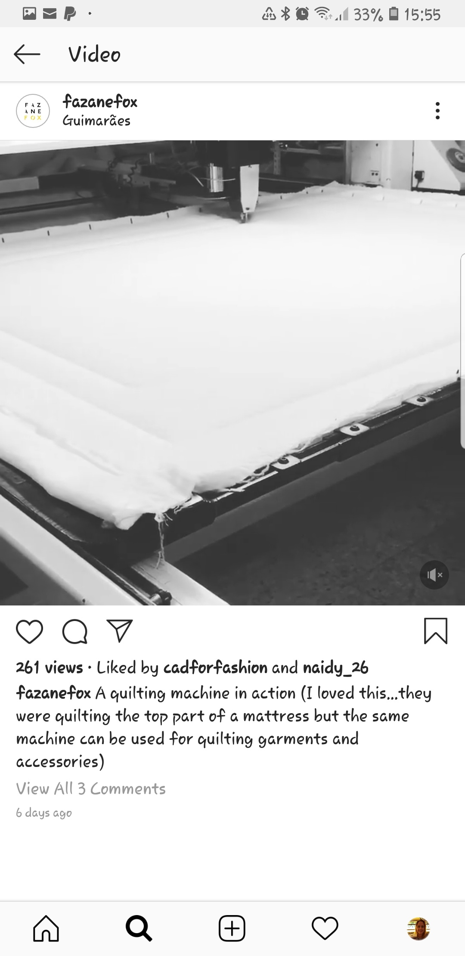
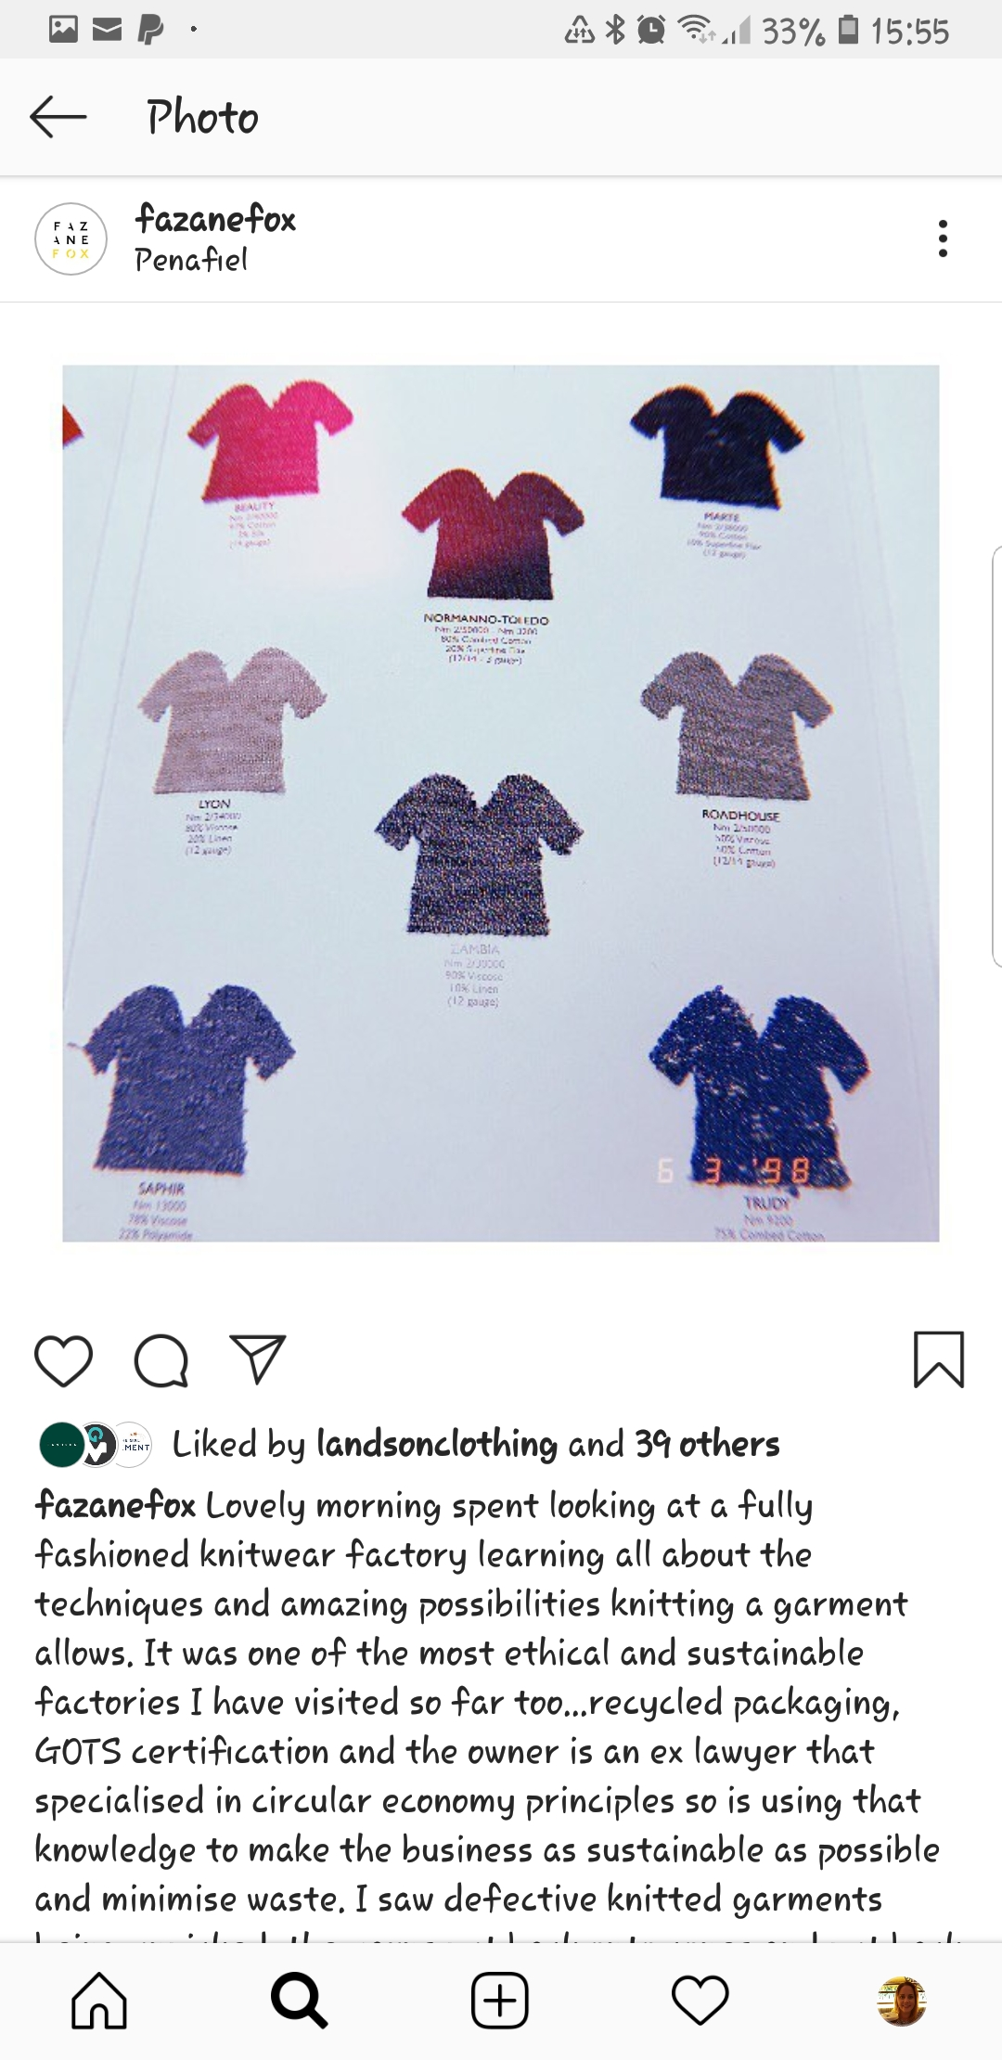
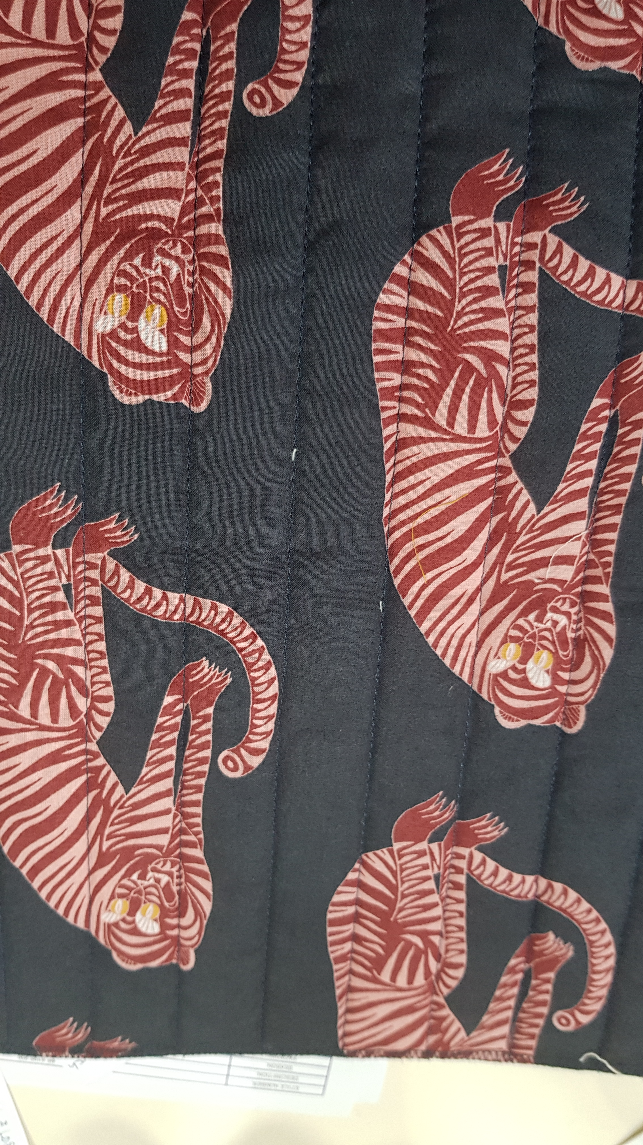
Fazane also visited a factory that specializes in quilting and also a factory that has produced products for many high class brands.

Slide 38
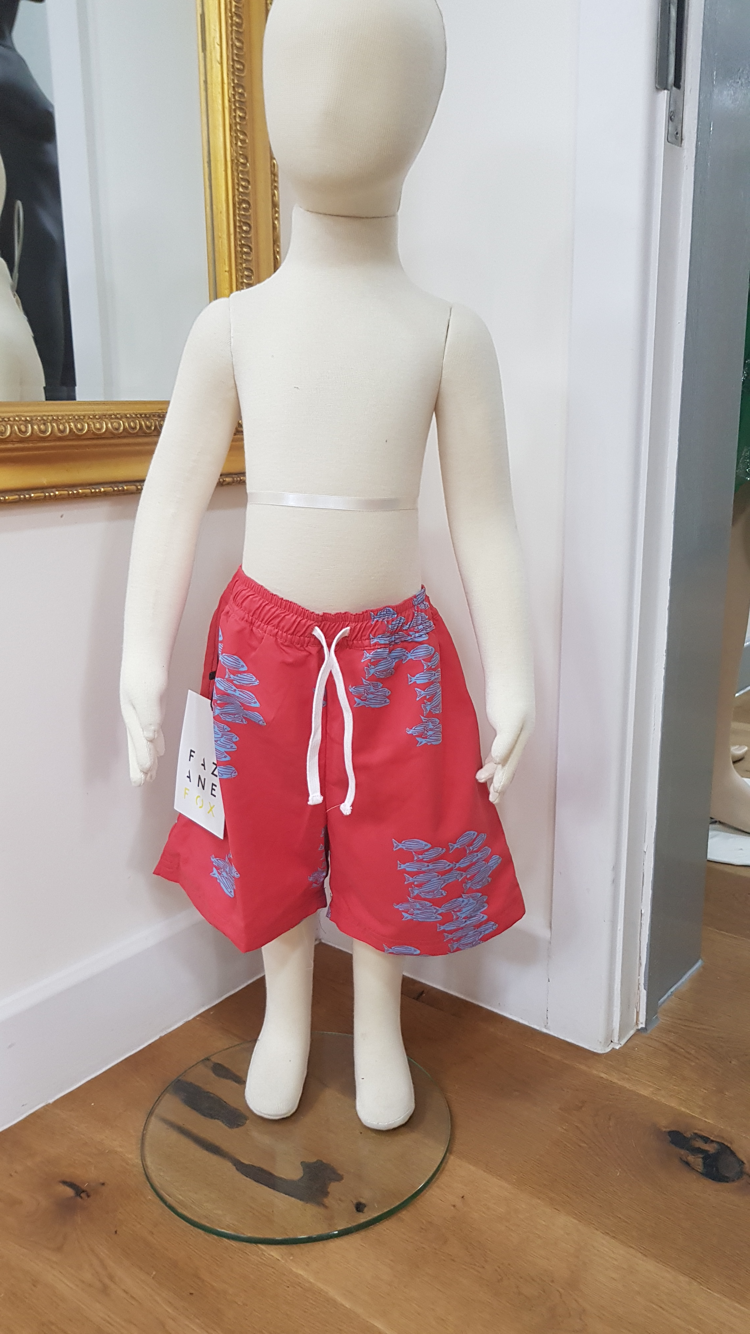
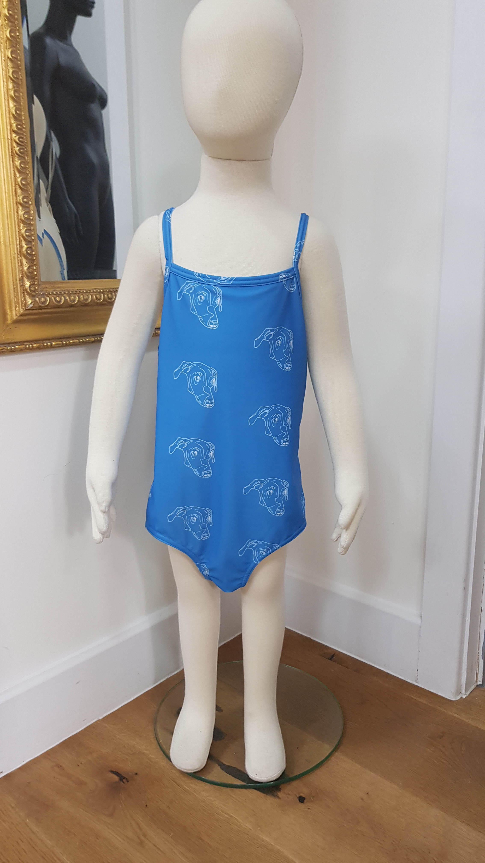
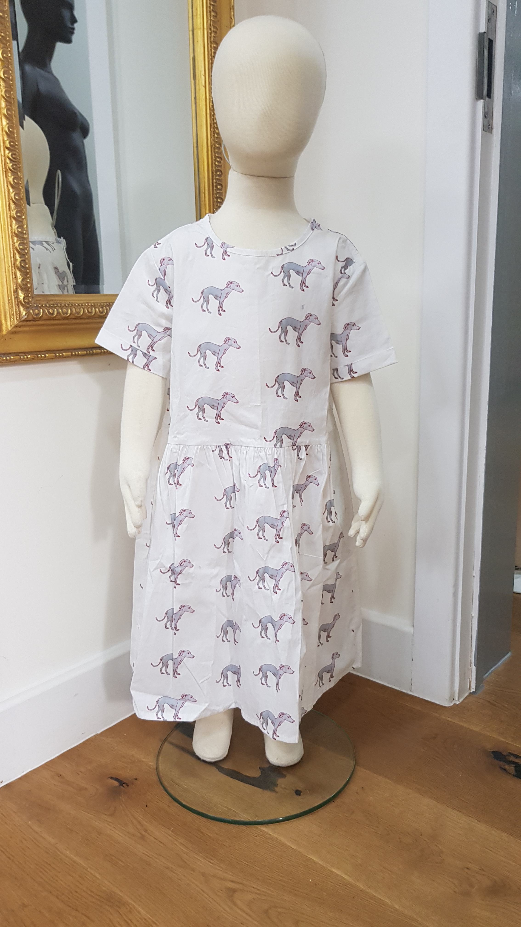
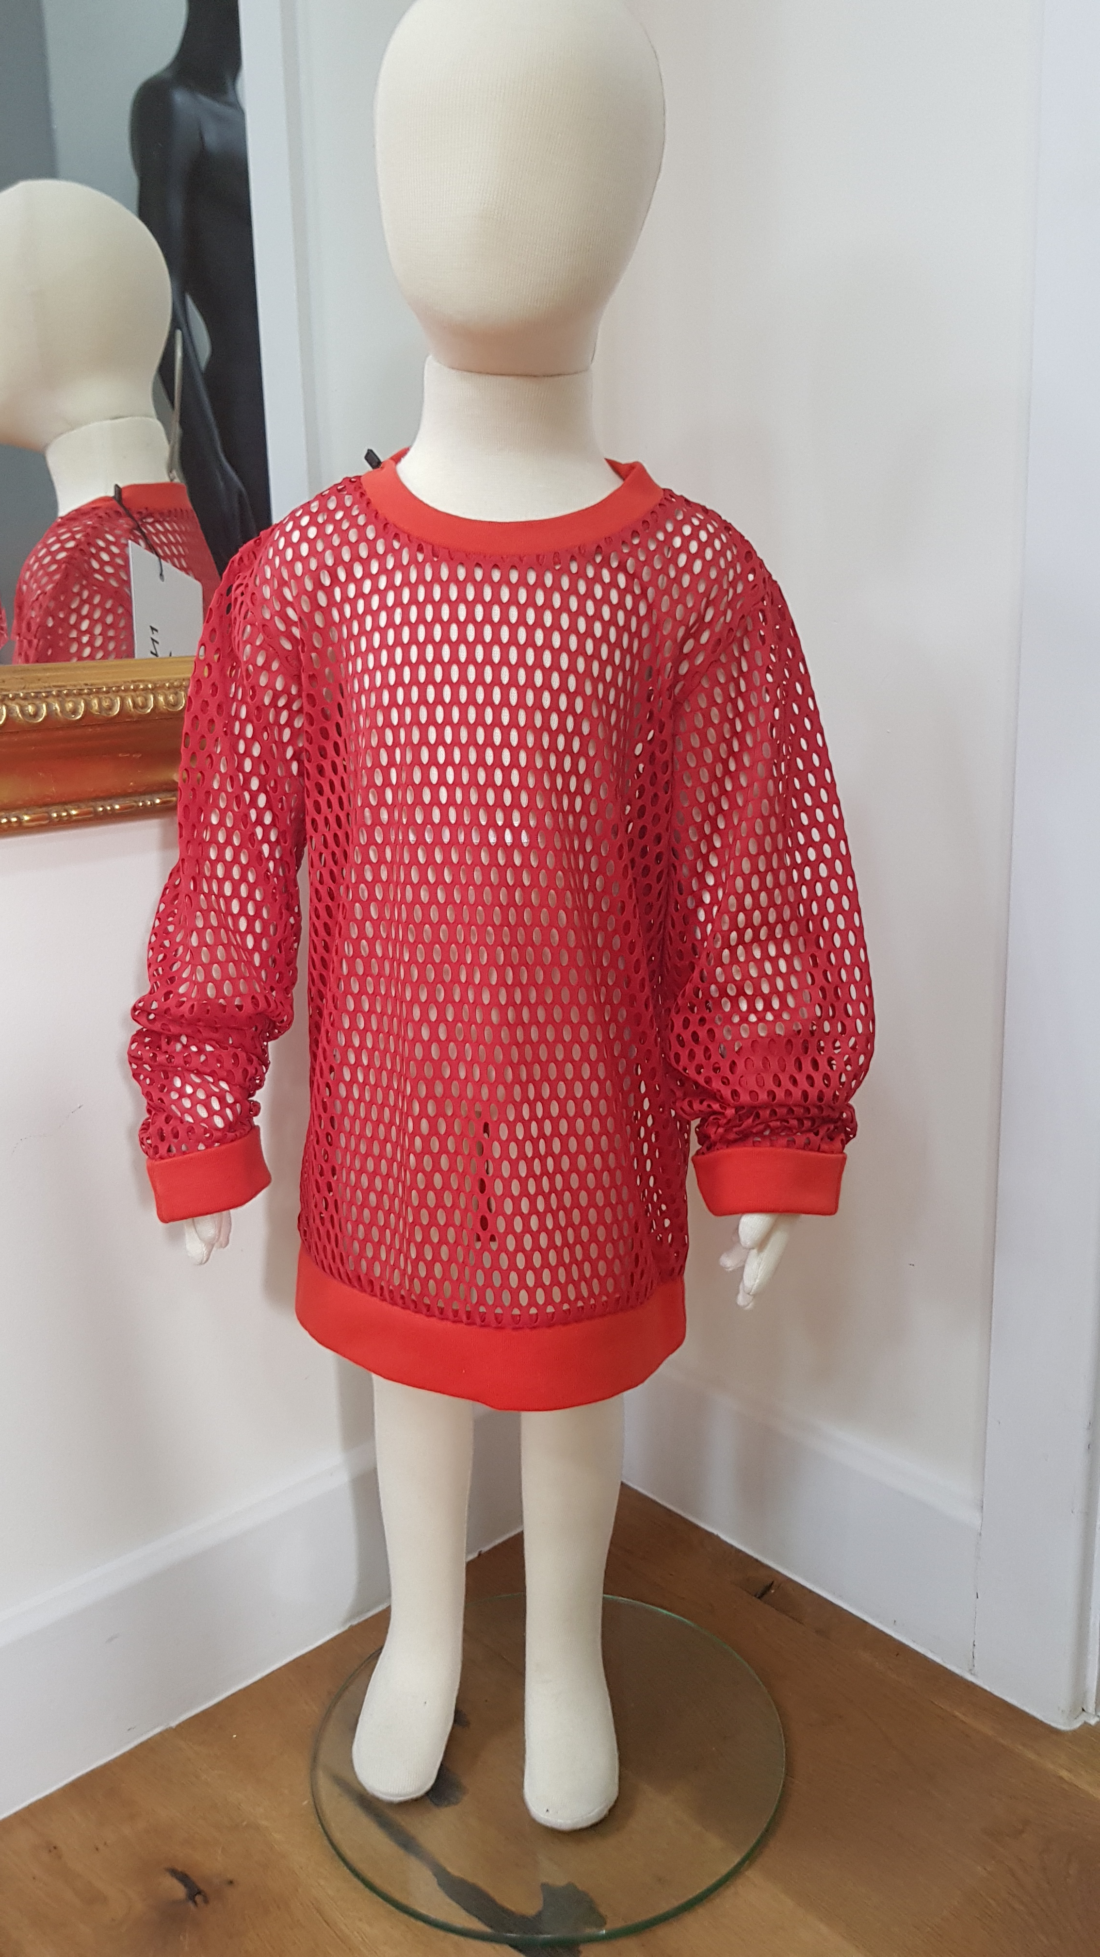
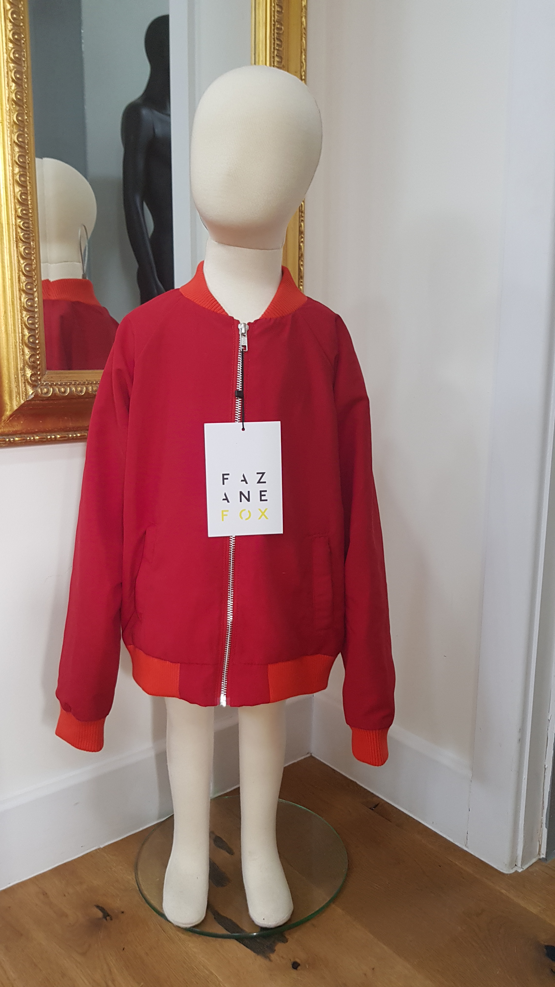
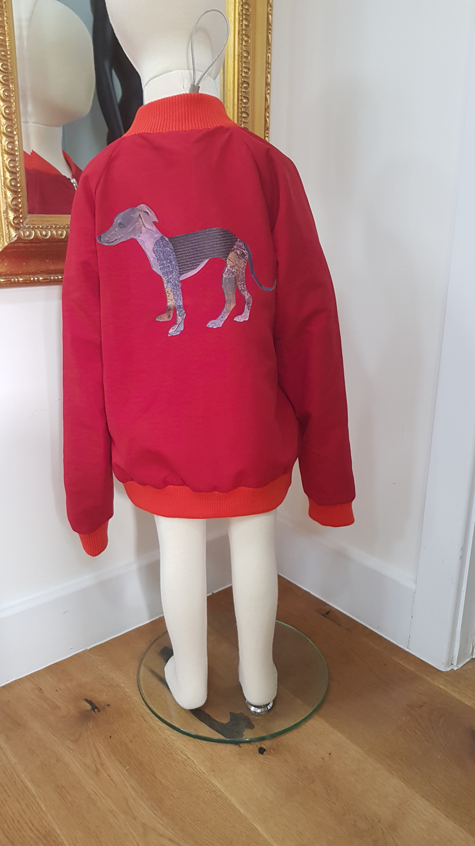
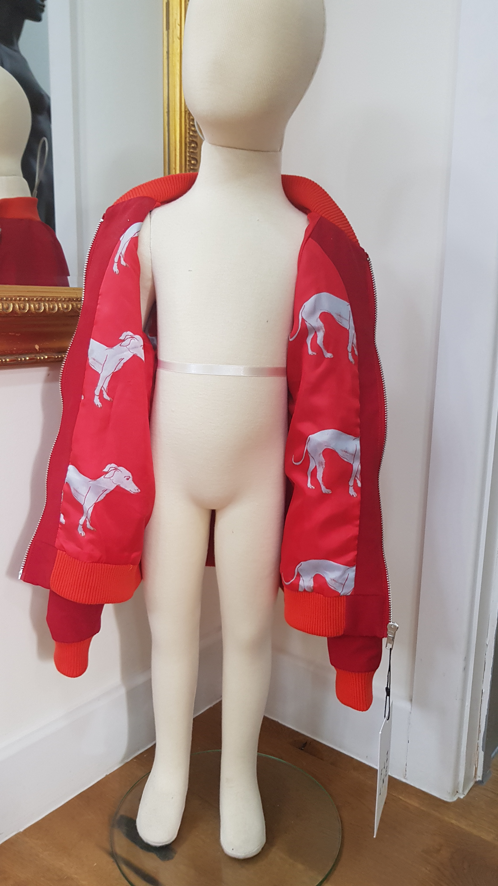
I also got to take photos of a Brand that already exists but would like us to do their development on there ss19 range. Here is a sneaky peek!

Slide 39
Some of our fabric suppliers
Vend Fabrics Ltd
Obradors
Armazen Dos Lintos
Taylor
Deniertex
Kroner and Schlikker
Kidermann
Such Textiles
John England
Diver Child
Texser

